Slide 1


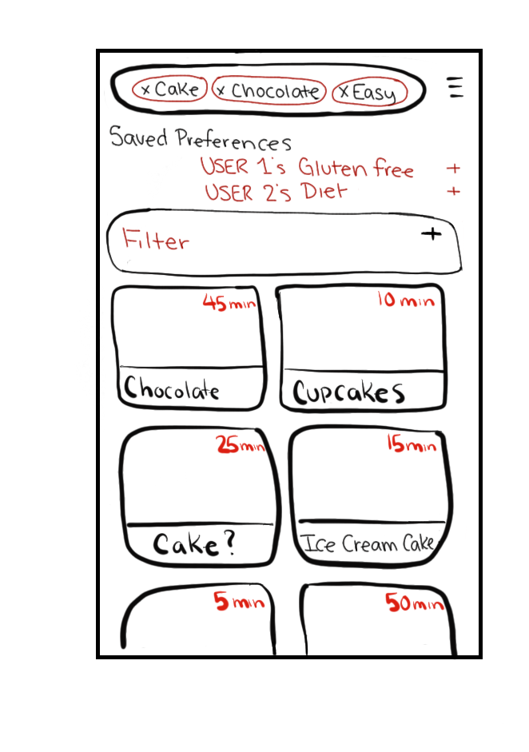
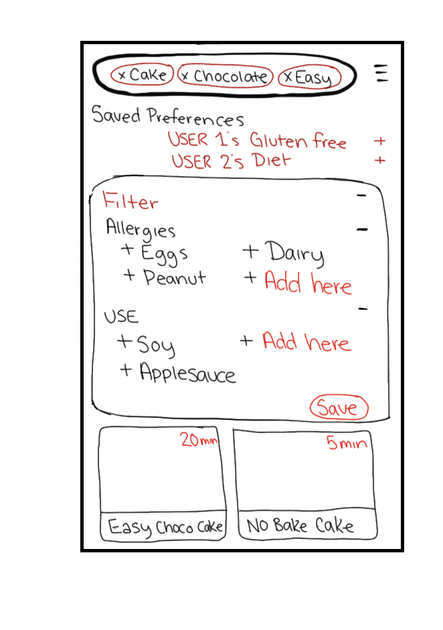

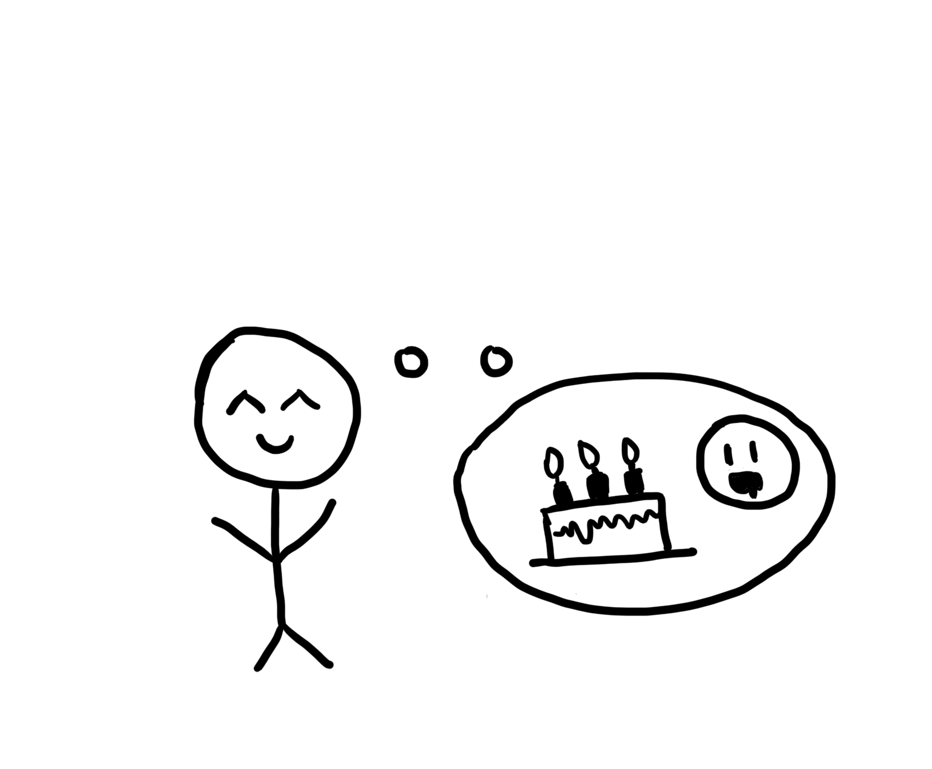

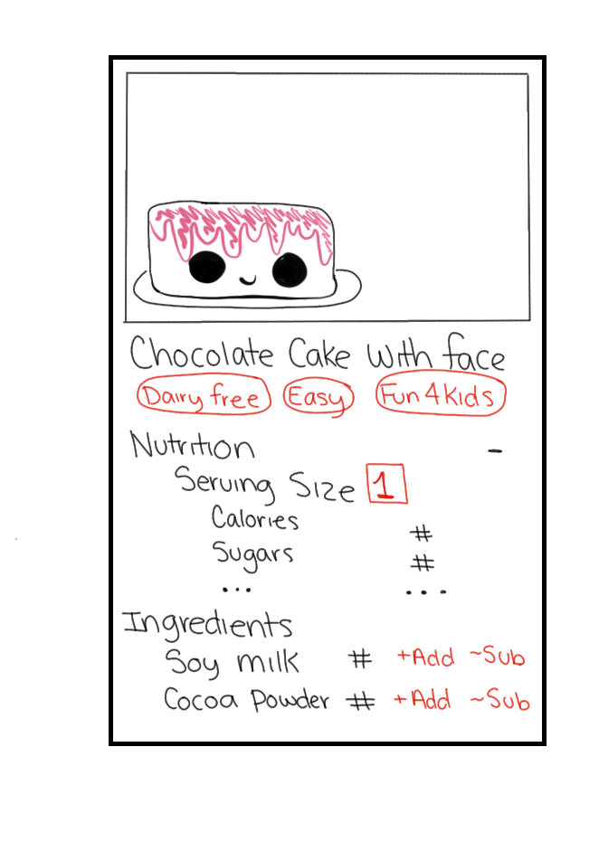
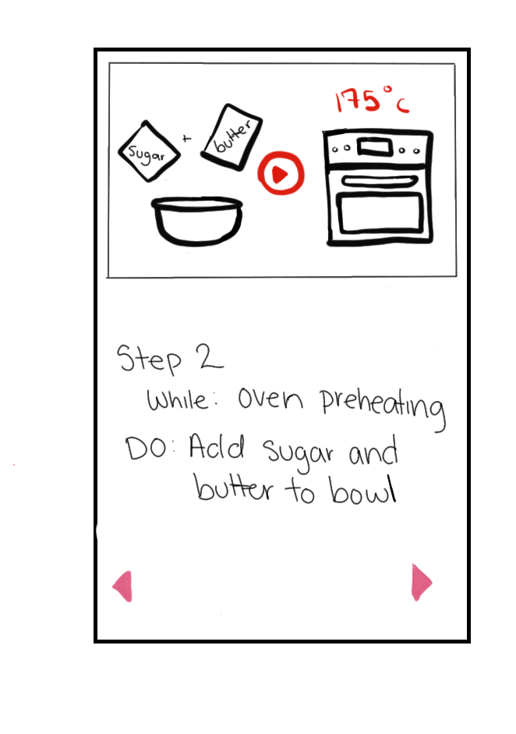

Feature: User, Searching For Recipe
User wants to make something new to eat. Opens application to search function.
In search function, User types separate filters to what they are looking for. Unable to find recipe they want to make.
User opens specific filters and searches using items they have in their home, and what items they need to avoid.
User finds a recipe they are looking for. Changes the serving size, substitute products and adds items to shopping list.
User looks through the easy recipes with step by step video tutorials, and searches up words they do not understand.
User decides to pick this recipe to use!

